Slide 1

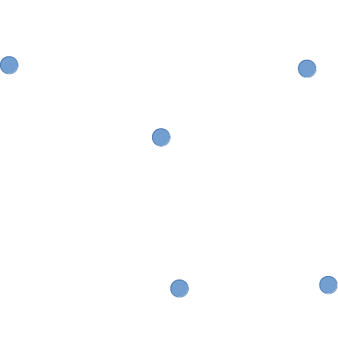
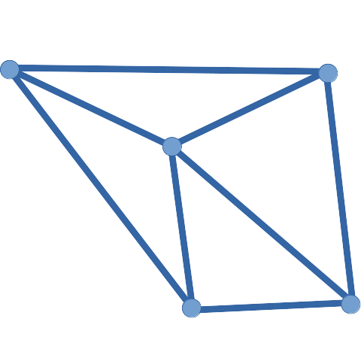
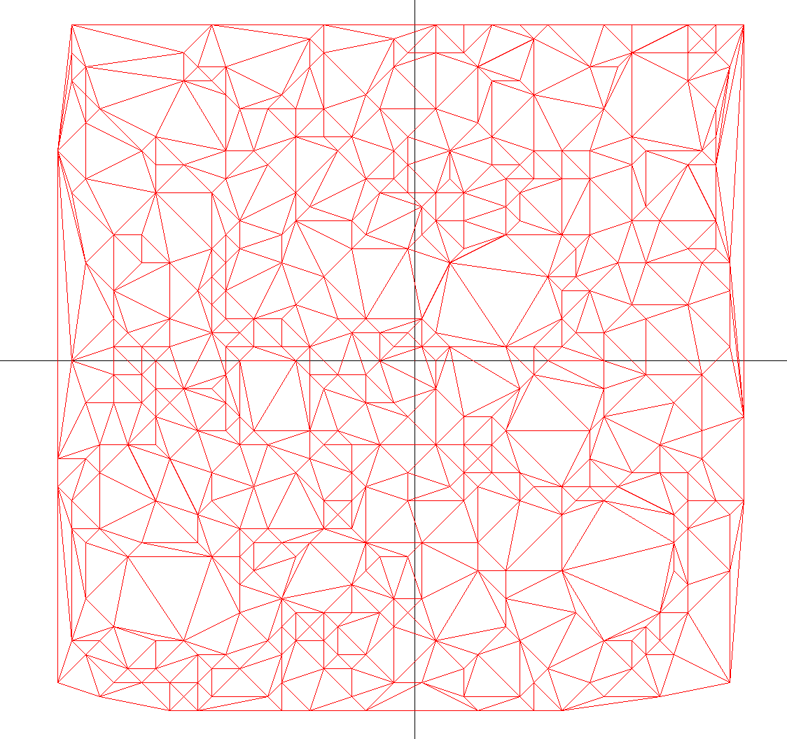
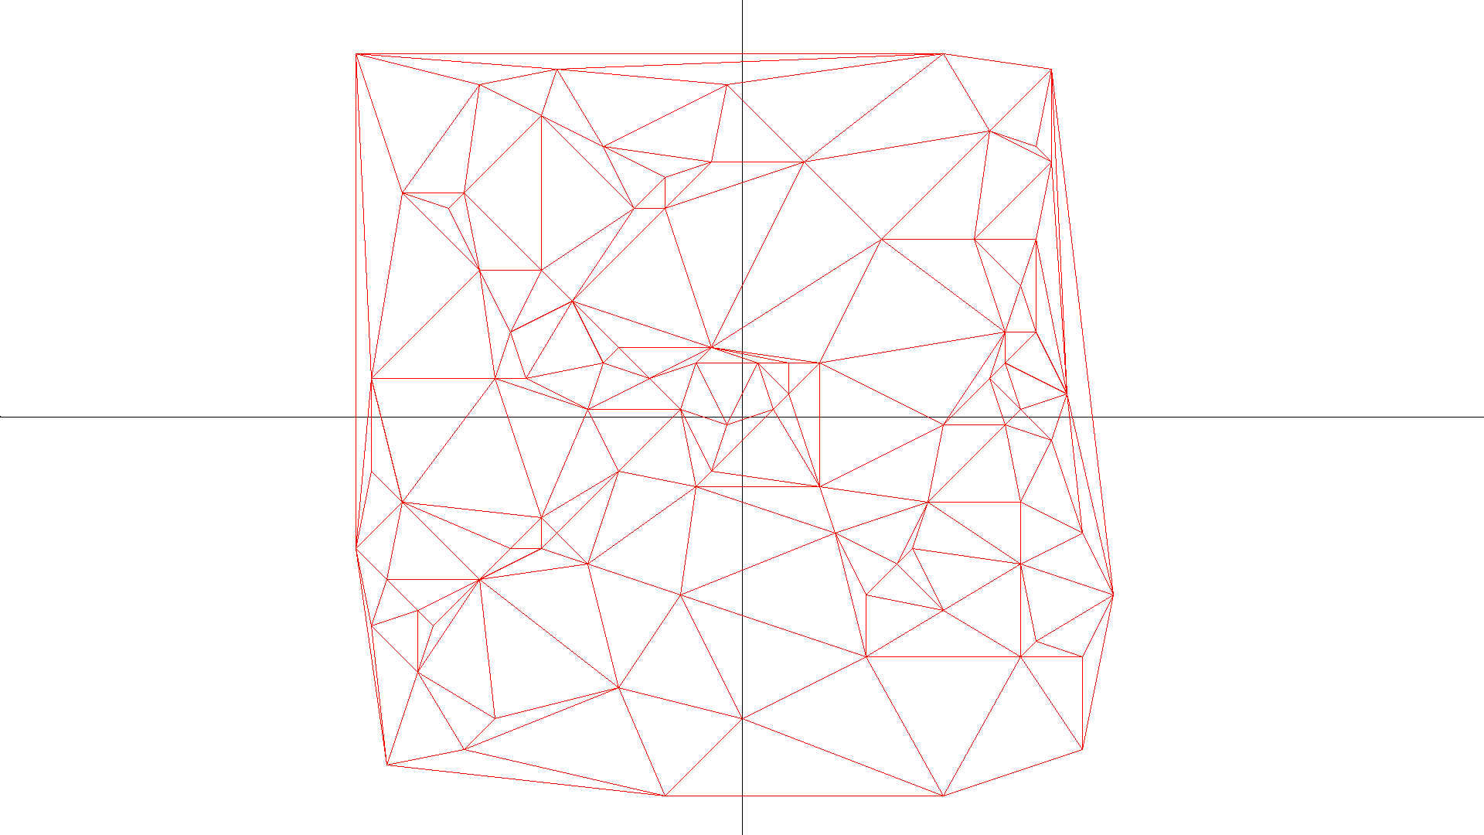
Greedy Triangulation
Eliza Shoemaker and Randy Shoemaker
The Problem
Parallelizing the Algorithm
Our goal is to take a set of points in the plane (called the point set) and produce the greedy triangulation. An example of a triangulation of a point set is shown in Figures 1 and 2. Different algorithms can be used to produce a triangulation. Greedy Triangulation algorithms greedily build a triangulation of a point set by successively adding the smallest line segment between any two points.
Phase One:
First we distribute a subset of the points to each process. Then each process calculates all the lines that occur between its points. Then using a binomial tree structure, each process sends its points or receive another process’s points. Then all the lines between the process’s ‘old’ points and the ‘new’ points. This repeats until process 0 has all the points.
Next process 0 collects all the calculated lines and distributes them out to all the processes. So phase 2 can begin.
Phase Two:
During this phase each process sorts its lines from smallest to largest length. Each process uses qsort from the C library to accomplish their sort.
Phase Three:
During this phase each process selects its smallest line and sends it to process 0. Process 0 finds the globally smallest line and adds it to the triangulation before broadcasting it to the other processes. Each process then throws out all lines that intersect with the smallest line. This step is repeated until each process has exhausted all of their lines.
Progress
Fig 1. A point set
Fig 2. Triangulation of the point set in Figure 1
We currently have a working parallel version. <INSERT ANALYSIS HERE>
Greedy Triangulation algorithms have been used to help tackle more complicated problems. The greedy triangulation has been used to give approximations of solutions for the Minimum Weight Triangulation (MWT) problem [1] which is NP-hard [2]. The MWT problem is as follows: given a point set produce a triangulation of minimal weight. In this context the weight of a triangulation is the sum of the lengths of the line segments forming the triangulation.
The greedy triangulation algorithm used in this work is an O(n⁴) algorithm. The triangulation is created in three phases. Phase one consists of generating all line segments between every two points in the point set. In the second phase the line segments are then sorted from smallest to largest. In the final phase the triangulation is produced by iteratively selecting the smallest line segment and removing from consideration all line segments which intersect it. Once this process is complete the point set has been triangulated. We implemented a serial version of this algorithm and a parallel distributed memory version using the Message Passing Interface (MPI) for C.
Point Set Size | Serial Version | Parallel 1 Proc | Parallel 2 Proc | Parallel 4 Proc | Parallel 8 Proc | Parallel 16 Proc | Parallel 32 Proc | Parallel 64 Proc
1000 | 026.49 | 043.77 | 020.70
1189 | 048.17 | 076.64 | 039.97
1414 | 093.42 | 154.34 | 080.54
1682 | 183.14 | 304.14 | 142.04
2000 | 338.93 | 545.72 | 262.74
2378 | 663.08 | 1006.36 | 515.84
Future Work
We plan to improve our parallel version by.…
References
[1] Jesper Jansson. Planar Minimum-Weight Triangulations. Lund University, Sweden. Retrieved from https://www.semanticscholar.org/
[2] Mulzer, Wolfgang, and Günter Rote. "Minimum-weight triangulation is NP-hard." Journal of the ACM (JACM) 55.2 (2008): 11.

